Slide 1
Beyond Digestion: Clinical Application of Enzymes
OVERVIEW
by Leyla El Moudden

Slide 2
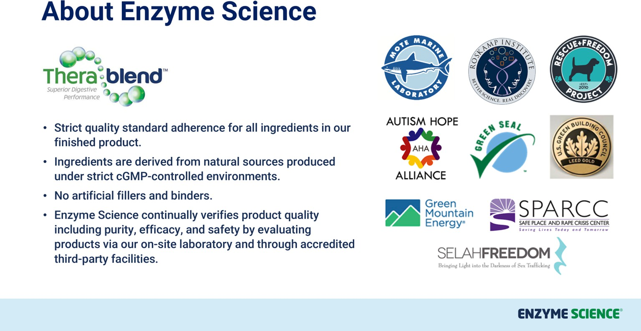
About Enzyme Science

Slide 3
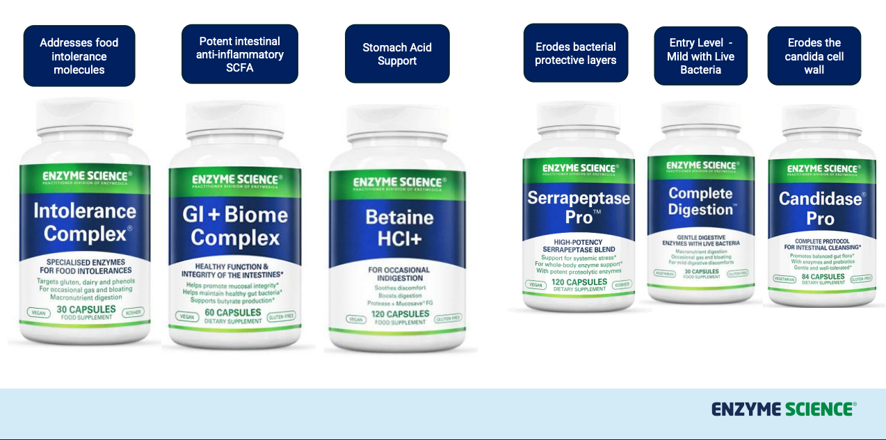
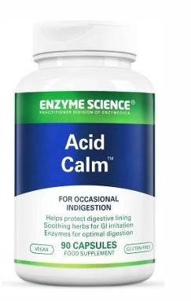
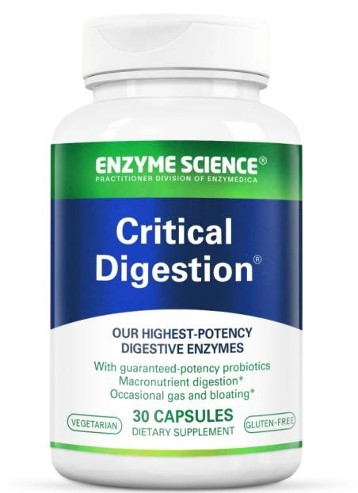
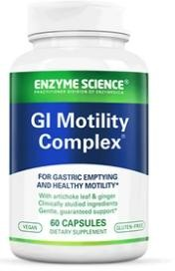
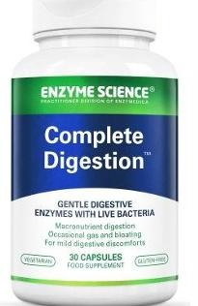




GLP-1 Support Suite
Large Capsule
Motility
Small Capsule
Best seller for heartburn
For Gut Health, Biofilm Disruption and Microbial Balance
Mucosa
Stomach acid

Slide 4
Learning Objectives
Understand digestive enzymes beyond nutrient breakdown
Identify when enzyme therapy may benefit gut ecology Recognise the role of enzymes in biofilm disruption
Integrate enzyme strategies into cclinical protocols for dysbiosis
Apply enzyme support in cases of Candida overgrowth and inflammatory gut patterns

Slide 5
The Clinical Problem
Many patients present with:
Partial response to antimicrobial protocols
Persistent bloating, gas, or dysbiosis Recurrent Candida patterns
Ongoing inflammatory signalling (LPS-driven inflammation) Relapsing SIBO or dysbiosis
What mechanisms might we be missing?

Slide 6
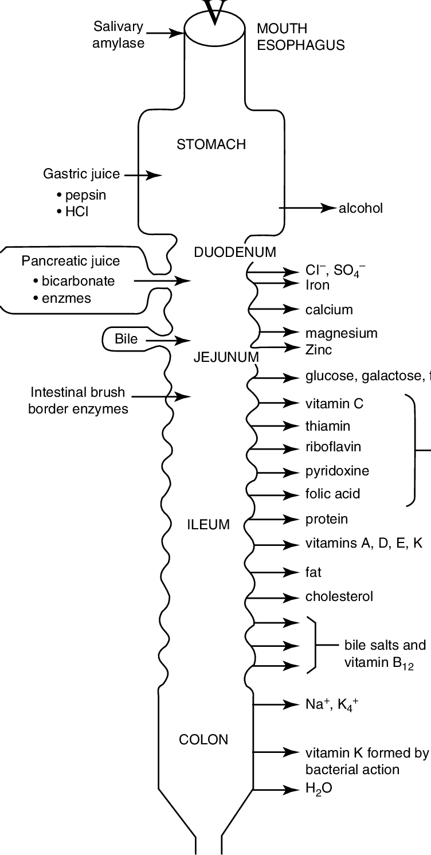
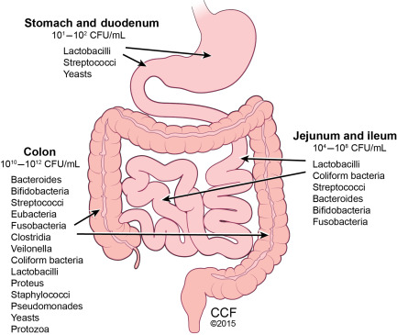
The Clinical Problem
Proteases |  | Lipases |  | Amylases
Lactase |  | Cellulases |  | Beta-glucanases
Produced primarily by the pancreas, stomach and small intestinal brush border

Slide 7
When Enzyme Function is Compromised
Factors that reduce enzyme production:
Chronic stress
Pancreatic insufficiency
Ageing
Chronic inflammation
Gastric hypochlorhydria
Gut dysbiosis
Factors that reduce enzyme activation
pH
Intestinal infection
Brush Border Inflammation
Leaky gut
Maldigestion
Nervous system

Slide 8
Practical Takeaways
Digestive enzymes may support:
Nutrient digestion
Gut microbial balance
Improved outcomes in dysbiosis protocols
Biofilm disruption strategies

Slide 9
The Expanding Role of Enzymes
Traditionally viewed as digestive aids
Microbial ecology modulation
Mucosal barrier function support
Inflammatory signalling regulation
Biofilm integrity disruption

Slide 10
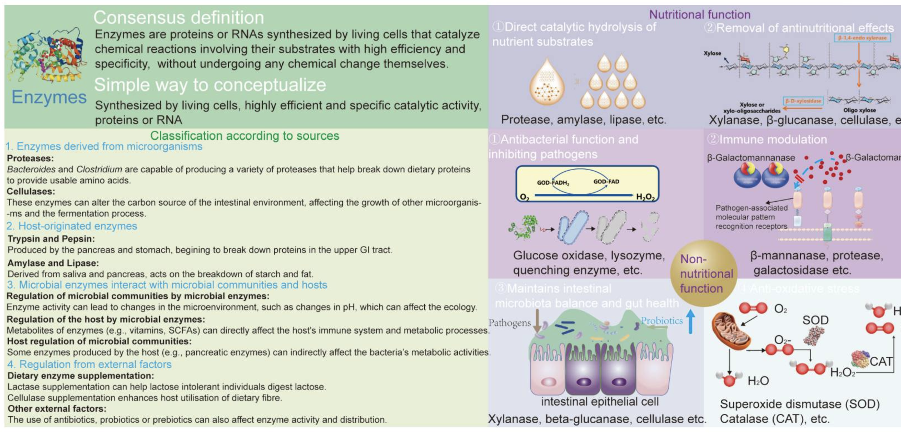
Microbial Modulation

Slide 11
Supporting Natural Enzyme Secretion
Gastric signalling
Adequate stomach acid stimulates pancreatic enzyme release via CCK and secretin
Cephalic phase digestion
Smelling, tasting and chewing food stimulates vagal signalling
Adequate protein intake
Protein strongly stimulates pancreatic protease secretion
Bitter compounds
Bitter foods and herbs stimulate digestive secretions (rocket, dandelion, gentian, artichoke)
Micronutrient sufficiency
Zinc, B vitamins and magnesium support enzyme synthesis
Always support physiology before relying on supplementation

Slide 12
Clinical Consequences of Reduced Enzymes
Maldigestion
↓
Fermentation & Microbial Overgrowth
↓
Immune Activation & Barrier Impairment

Slide 13
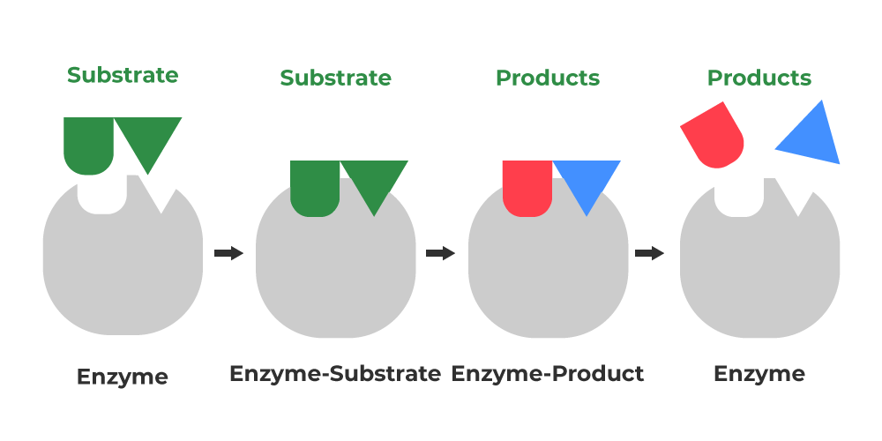
Enzymes and Gut Ecology
Undigested food substrates may:
Feed opportunistic microbes
Shift microbial balance
Promote dysbiosis

Slide 14
Dysbiosis and Persistent Gut Symptoms
Common Clinical Patterns:
Candida overgrowth
SIBO relapse
Food intolerance
LPS

Slide 15
LPS and Inflammatory Signalling
Lipopolysaccharide (LPS) is an endotoxin from Gram-negative bacteria
LPS can trigger:
Immune activation
Gut barrier disruption Systemic inflammation

Slide 16
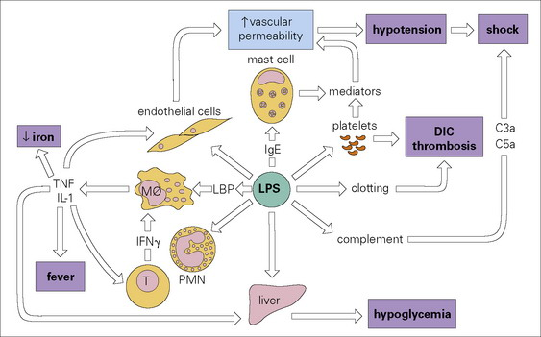

Slide 17
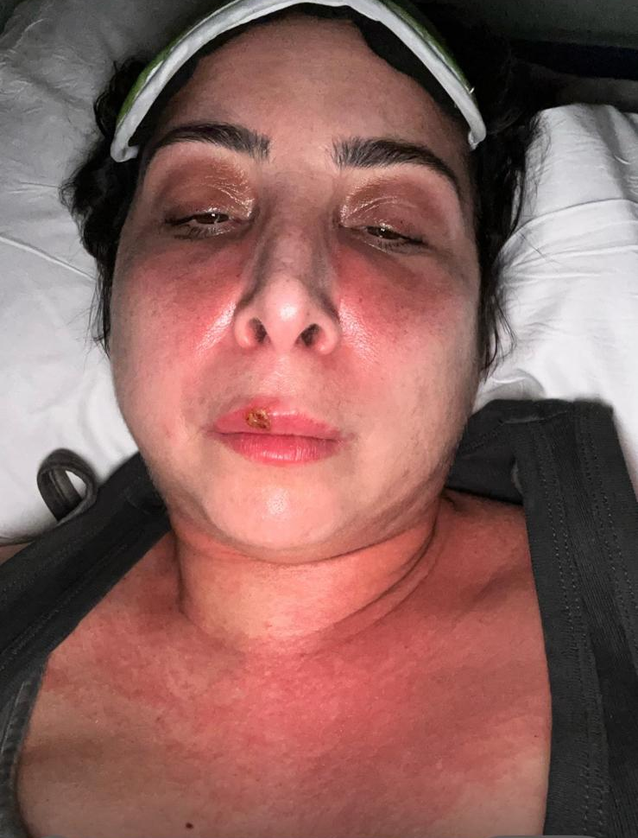

High LPS
Stop the leak
Reduce the inflammation
3. Handle Oxidative Stress
4. Increase aminos
5. Manage stress

Slide 18
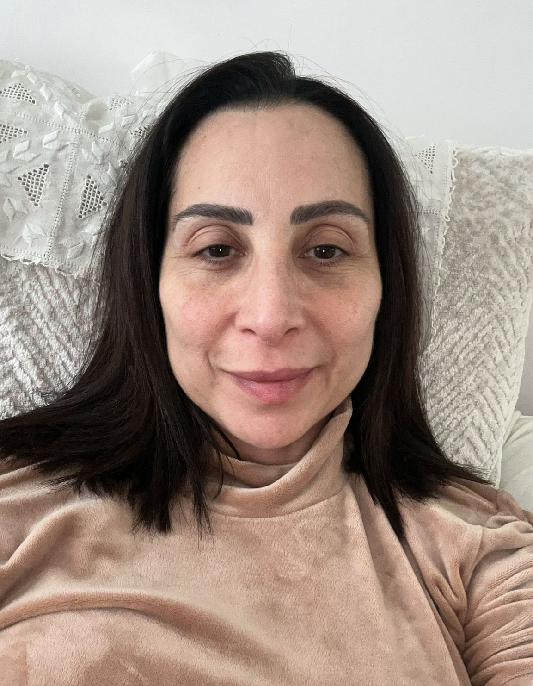
What we did:
Butyrate
Absorb Elements Elemental Shake
Aminos Nervine Tonic
Then when she was out of the danger zone Proteolytic Enzymes Digestive enzymes with meals Nervine Tonic
Today – Aminos only, occasional sleep support

Slide 19
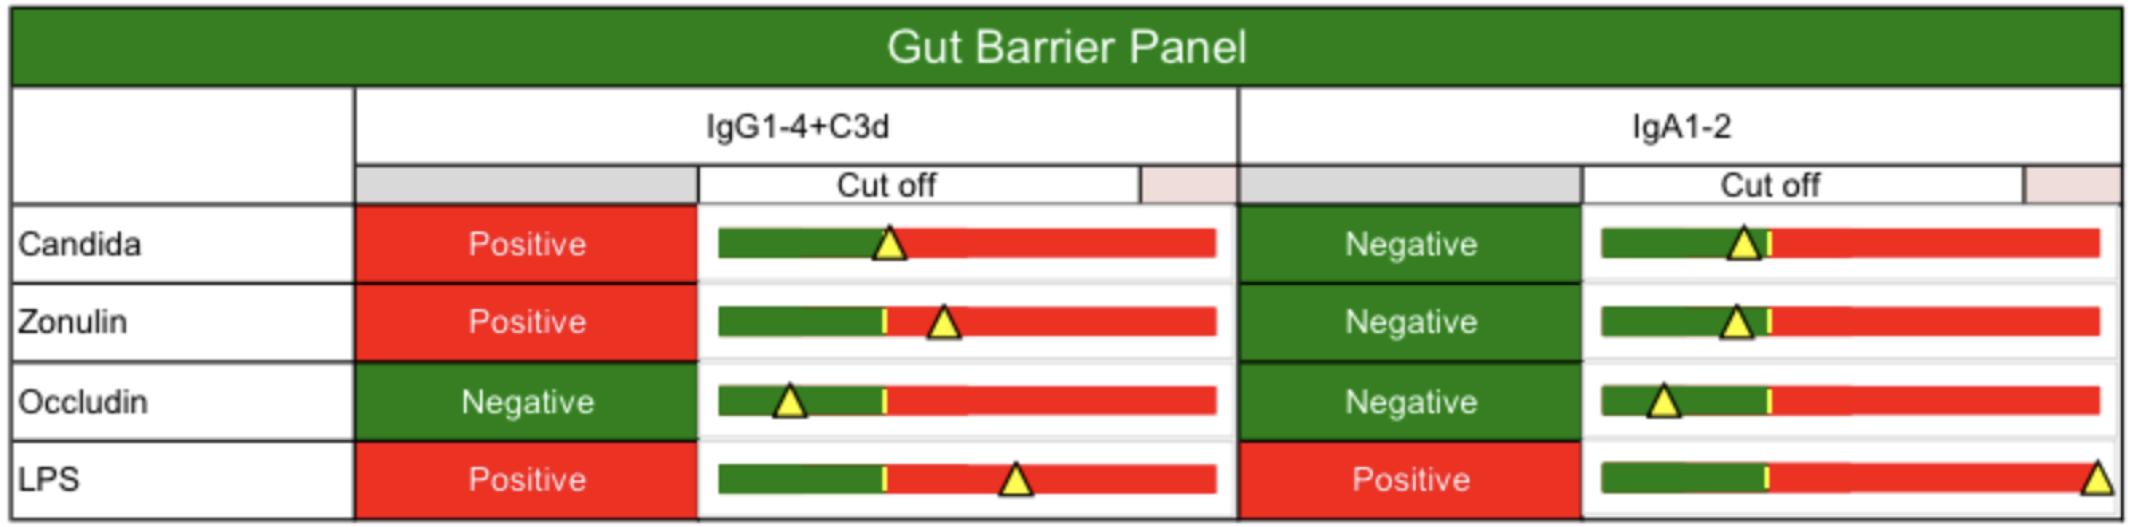
High LPS
Systemic Response
Mucosal Response

Slide 20
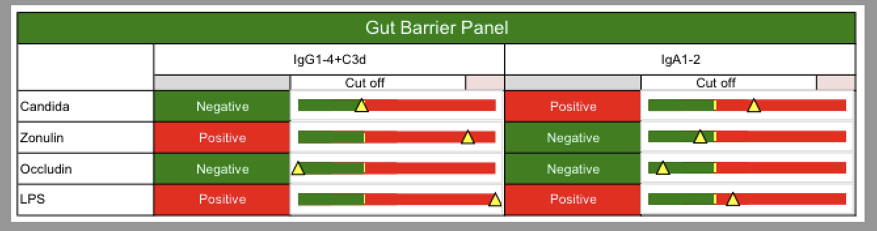
LPS
Systemic Response
Mucosal Response

Slide 21

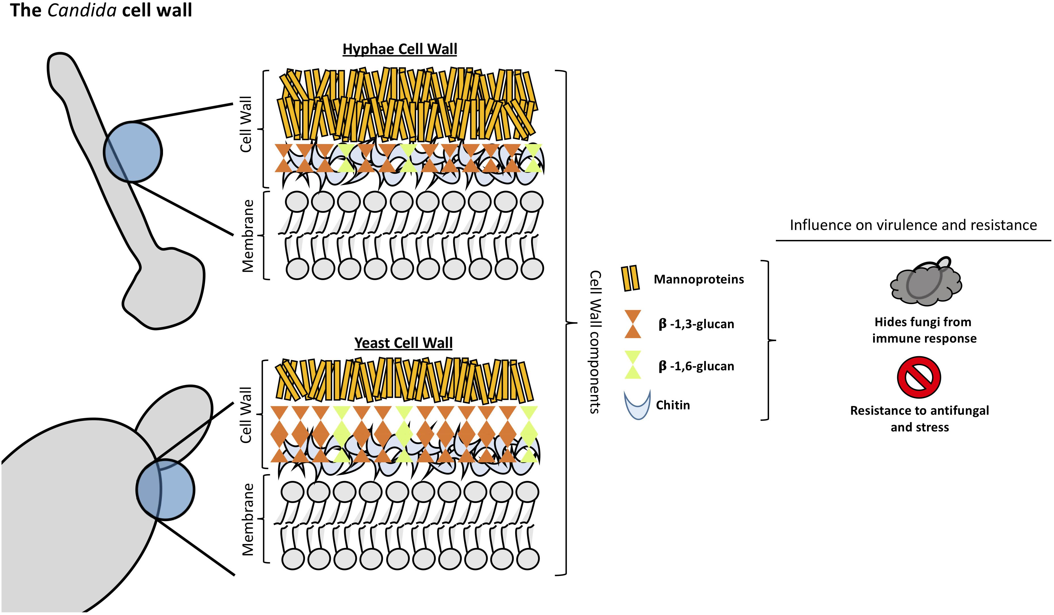
What is candida?

Slide 22
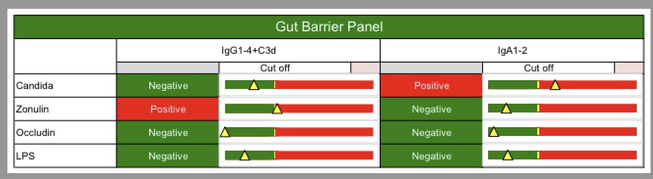
Systemic Response
Mucosal Response

Slide 23
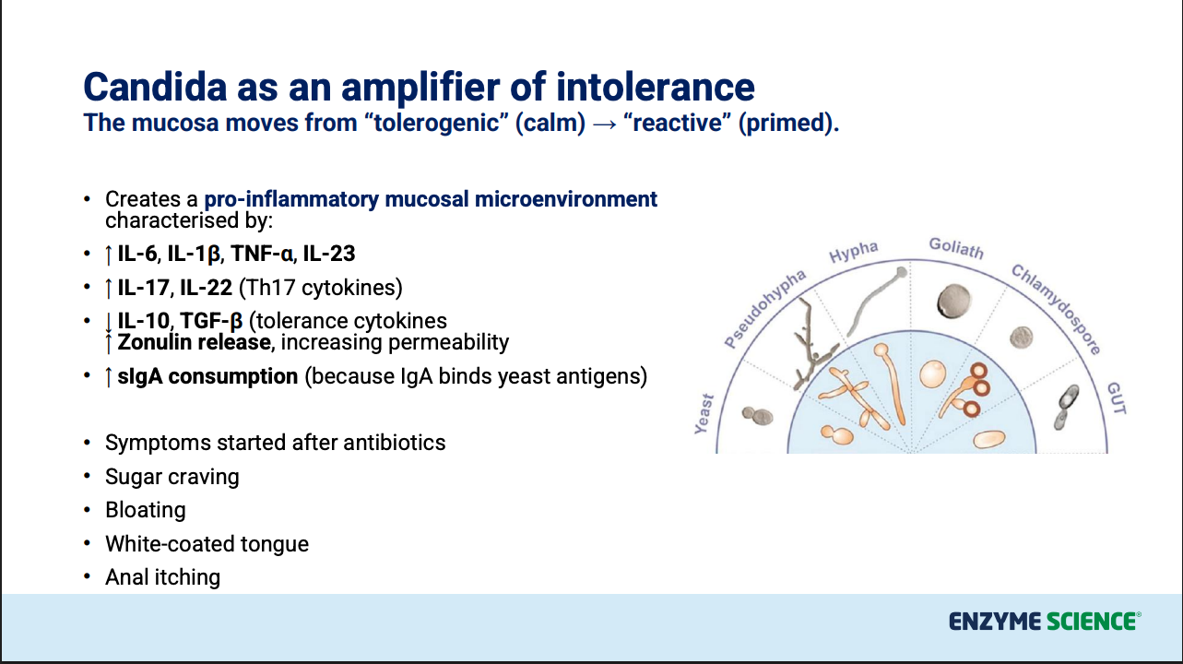

Slide 24
Candida
DX: Intestinal Candida
Candida
Week 1 - 2
Week 2-4
Week 4+
Timeframe
Candidase Pro + Digestive Enzyme + Antifungals
Dietary Adjustment – LOW sugar,
instead of no sugar
If Herx: Lower the dose temporarily Add binders (charcoal, chlorella) Support the liver (NAC, milk thistle)
Prokinetics Between Meals Add Biofilm protocol if indicated
Inhibiting regrowth Candidase Pro + Diet +
S. boulardii, L. plantarum, L.
rhamnosus, B. breve
Gut Repair – Mucus Membrane
Mild – 3-4 weeks Moderate – 6-8 weeks Recurrent – 12+ weeks
Breath Test
Disclaimer
This information provided for educational purposes only and does not substitute for professional medical advice. Please consult a medical professional or healthcare provider for immediate medical advice, diagnoses, or treatment.
These clinical trees are guidelines only - and practitioners should discern and make their own judgements regarding patient care.

Slide 25
Candida and Biofilms
Candida species frequently form biofilms which:
Enhance survival
Resist antifungal agents Contribute to relapse
Targeting the biofilm matrix may improve outcomes

Slide 26
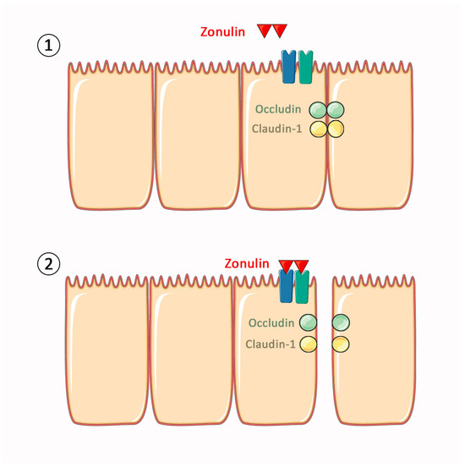
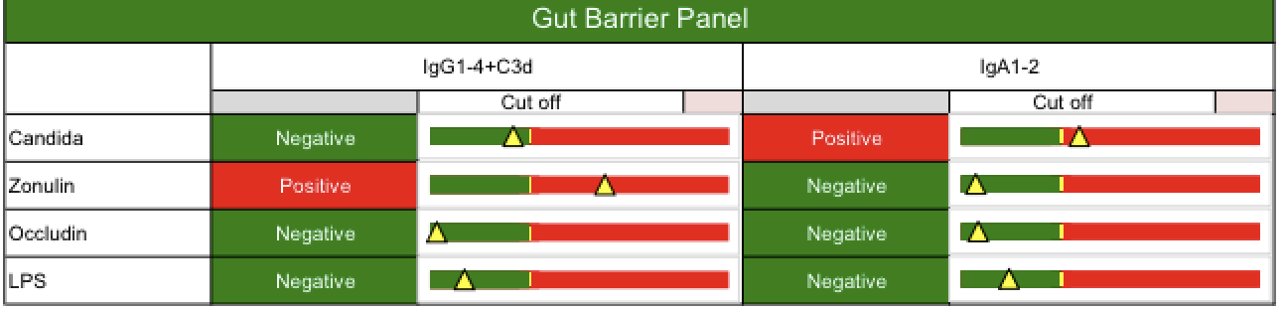
Zonulin

Slide 27
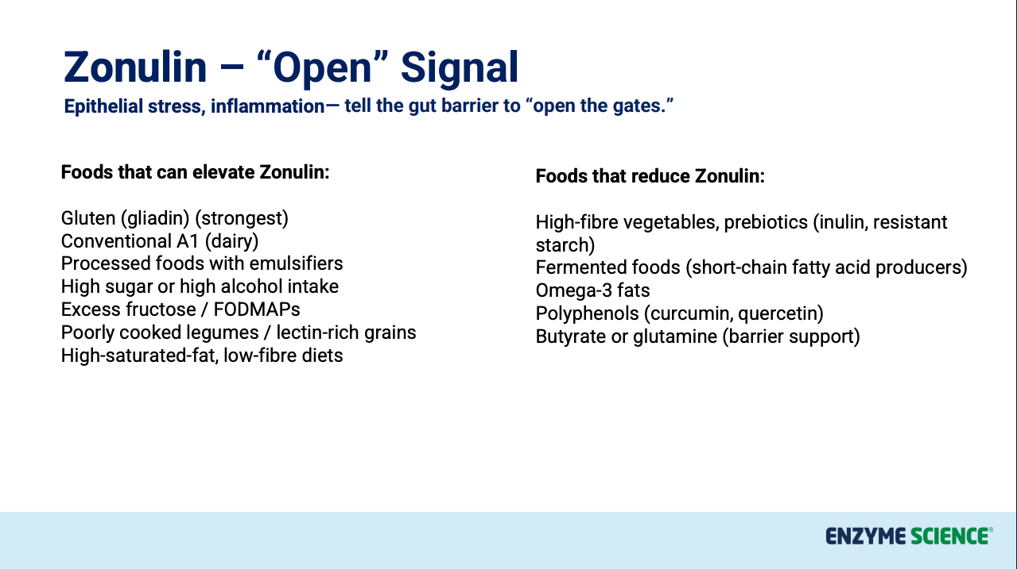

Slide 28
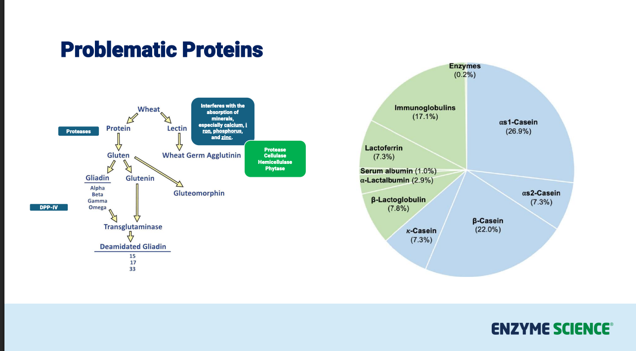

Slide 29
Understanding Biofilms
Protective microbial matrices that allow microbes to evade immune responses and resist antimicrobials
Biofilm Components:
Polysaccharides
Proteins
Lipids
Extracellular DNA

Slide 30
Clinical Relevance of Biofilms
Biofilms may contribute to:
Persistent dysbiosis
Antimicrobial resistance
Chronic gastrointestinal symptoms
Ongoing inflammatory signalling

Slide 31
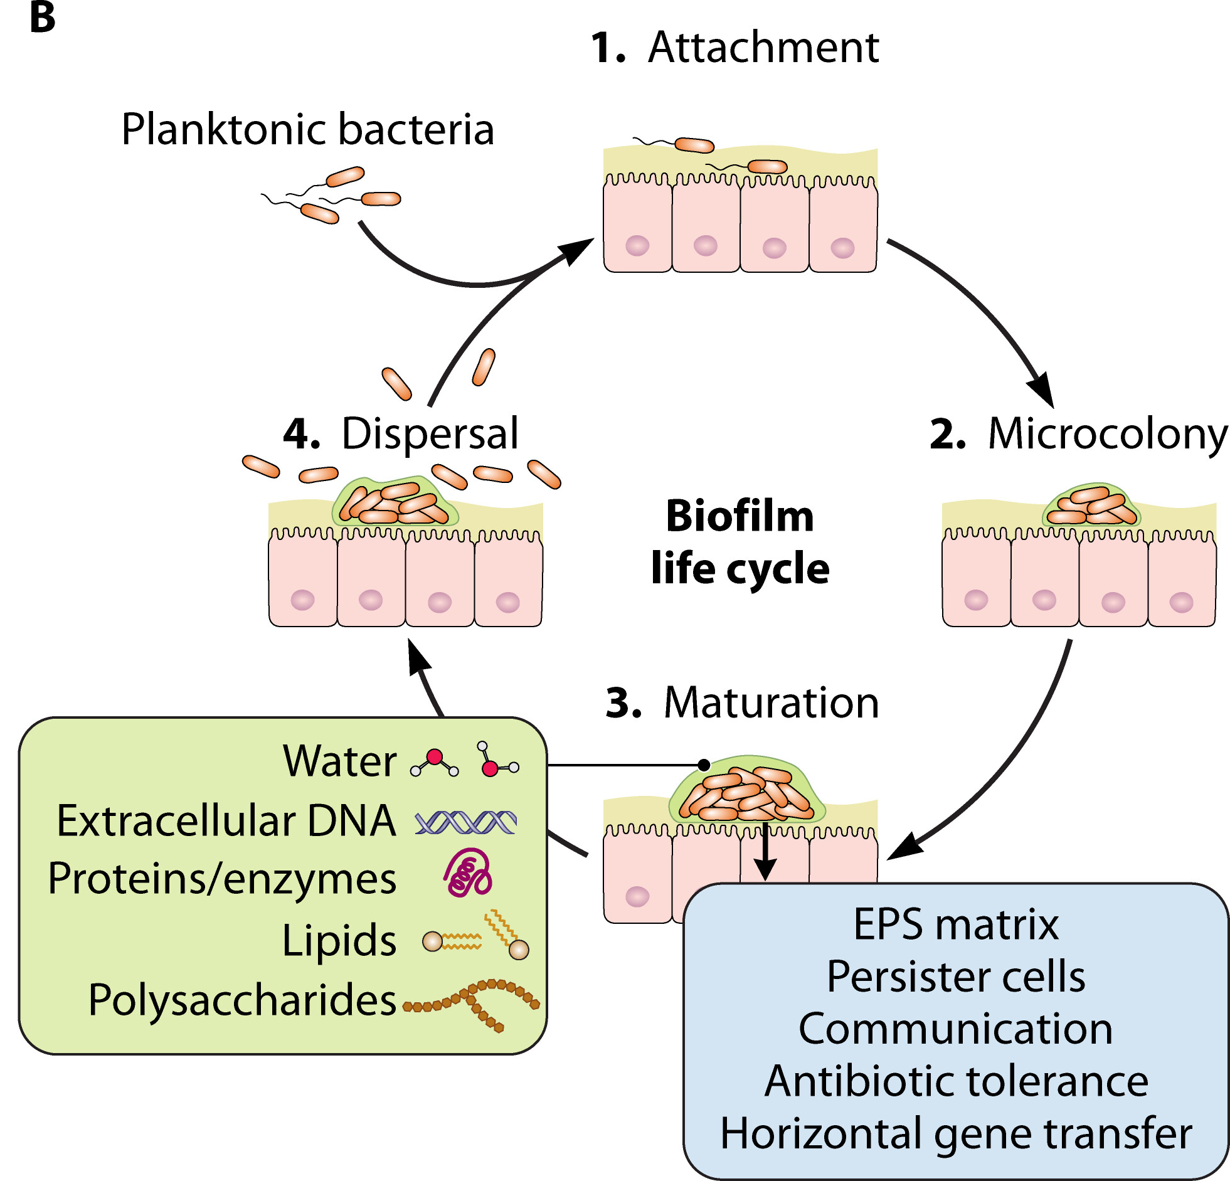
Enzymes as Biofilm Disruptors
Certain enzymes can degrade biofilm structures
Biofilm-Disrupting Enzymes:
Proteases
Cellulases
Hemicellulases Beta- glucanases
May increase microbial susceptibility to treatment

Slide 32
BioFilm
DX: Resistance
2x Daily Until You Get The Result – av. 2 weeks
First dose |  | 30 mins later |  | 1 hour later |  | Daily
Take 2 capsules of Nattokinase. Take 2 caps Serrapeptase Pro Take a strong chelator alongside the enzymes (e.g., calcium disodium EDTA or modified citrus pectin) |  | Take one antimicrobial per day — rotate through the following options: Herbal: berberine, artemisinin, citrus seed extract, black walnut hulls, artemisia, echinacea, goldenseal, gentian, tea tree oil, fumitory, galbanum oil, oregano oil, neem. |  | Take binders to mop up die-off debris and toxins: - Chitosan, citrus pectin, special bicarbonate formula, organic germanium, chlorella, and others |  | Use buffering agents such as buffered vitamin C. Purpose: Counteract acidity created during microbial die-off and support pH balance. Assess and replete essential minerals such as magnesium, zinc, and others based on individual need
Breath Test
Disclaimer
This information provided for educational purposes only and does not substitute for professional medical advice. Please consult a medical professional or healthcare provider for immediate medical advice, diagnoses, or treatment.
These clinical trees are guidelines only - and practitioners should discern and make their own judgements regarding patient care.

Slide 33
Enzymes and Gut Barrier Integrity
Improved digestion reduces antigen exposure and immune activation
This can support:
Enhanced mucosal integrity
Reduced endotoxin exposure
Improved inflammatory balance

Slide 34
Timing and Strategy
Digestive enzymes Typically taken with meals
Biofilm-targeting enzymes Often used away from meals
Clinical strategy depends on therapeutic goal

Slide 35
Example Clinical Pattern
Patient Presentation:
Chronic bloating History of Candida
Partial response to antifungals
Possible Contributing Factors:
Biofilm protection
Undigested substrates feeding microbes

Slide 36
Enzyme interactions?
Enzymes may be combined with:
Antimicrobials
Probiotics
Prebiotics
Mucosal support nutrients
Dietary interventions

Slide 37
Clinical Indicators for Enzyme Use
Consider enzymes when patients present with:
Bloating after meals Undigested food in stool Protein intolerance Chronic dysbiosis
Incomplete response to antimicrobials

Slide 38
Safety Considerations
Appropriate dosing
Patient sensitivity assessment
Medication interactions
Professional supervision required

Slide 39
Key Clinical Questions
When patients relapse or plateau, ask:
Is digestion adequate?
Are microbes protected by biofilms?
Are inflammatory triggers still present?

Slide 40
Summary
Digestive enzymes have roles beyond digestion
They may influence:
Microbial ecology
Inflammatory signalling
Biofilm integrity
Gut barrier function

Slide 41
Questions
Thank you for your attention
Leyla El Moudden Dip Herb, Dip Nat, mGNC

